Slide 1
Capstone Project
Zomato Restaurant Clustering and Sentiments Analysis Team
Rahul Kumar Soni, Lakdawala Ali Asgar

Slide 2
Content
Introduction
Problem Statement
Data Summary
Approach Overview
Exploratory Data Analysis
Modelling Overview
Challenges
Conclusion
Notes:
A short introduction of zomato
Given problem statement
overview of approach that we followed

Slide 3
Introduction
In today’s digitized modern world, the popularity of food apps is increasing due to their functionality to view, book, and order food with a few clicks on the phone for their favorite restaurant or cafes, by surveying the user ratings and reviews of the previously visited customers. Zomato is a site where someone can give a review of a restaurant, how the restaurant is, and someone's opinion about the restaurant.

Slide 4
Problem Statement
Create hotel clusters based on cuisines and sentiment analysis of the customer reviews

Slide 5
Data Summary
Zomato Restaurant names and Metadata (clustering)
Name: Name of Restaurants
Links: URL Links of Restaurants
Cost: Per person estimated Cost of dining
Collection: Tagging of Restaurants w.r.t. Zomato categories
Cuisines: Cuisines served by Restaurants
Timings: Restaurant Timings

Slide 6
Data Summary
Restaurant: Name of the Restaurant (sentiment analysis )
Reviewer: Name of the Reviewer
Review: Review Text
Rating: Rating Provided by Reviewer
MetaData: Reviewer Metadata - No. of Reviews and followers
Time: Date and Time of Review
Pictures: No. of pictures posted with the review

Slide 7
Pipeline
Data Cleaning
Data Exploration
Modeling
Understanding and Cleaning
Null value analysis
Missing value treatment
Outlier Treatment
Graphical
Univariate analysis with visualization
Bivariate Analysis
with visualization
Machine Learning
Clustering
Topic Modeling
Classification
Notes:
Topic modeling or unsupervised sentiment analysis
Classification or supervised sentiment analysis

Slide 8
Basic Exploration
Data of 105 restaurants.
Data of 9000 reviews
3 years of customer’s reviews
0.36 percent null values were present.
50 percent of collection data is missing
Average price of a Restaurant ranges from 150 to 2800
Notes:
0.36 percent of null values were present in reviews data
50 percent of collection data is missing which contained the taggs given by zomato to a restaurant

Slide 9
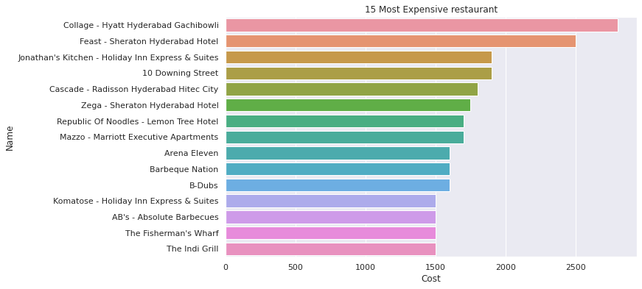
15 Most expensive Restaurants

Slide 10
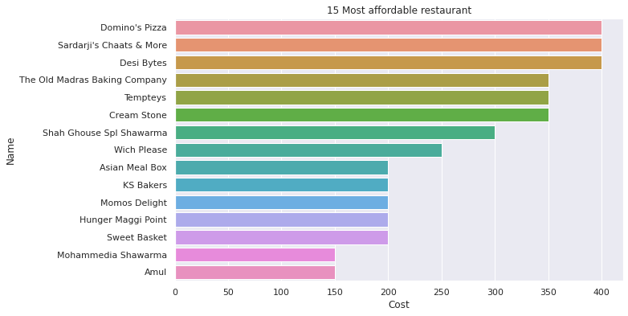
15 most Affordable Restuarents

Slide 11
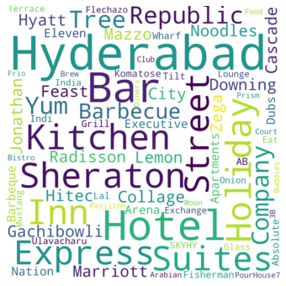
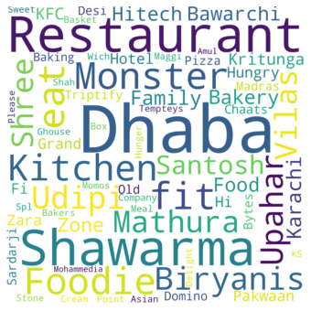
Frequent Keywords Used for Restaurant
Most Expensive
Most Affordable

Slide 12
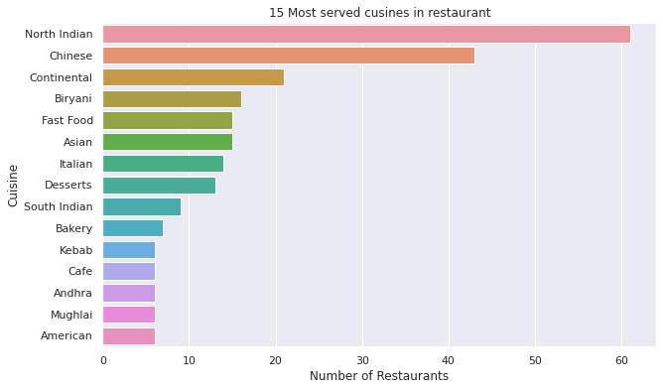
15 Most Served Cuisines

Slide 13
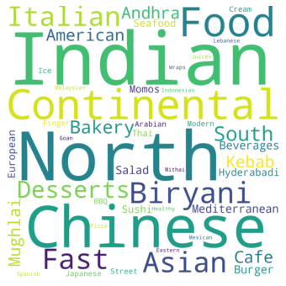
Frequent Keyword Used for cuisine

Slide 14
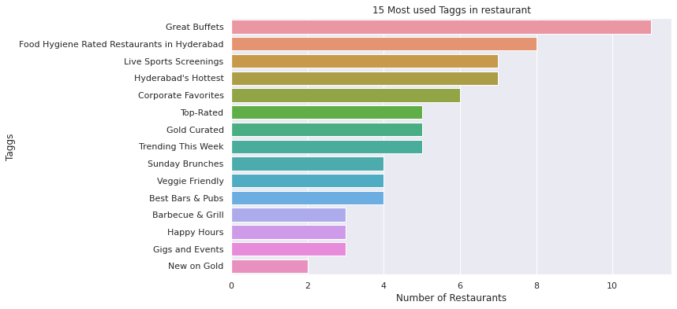
Most used tags for Restaurants

Slide 15
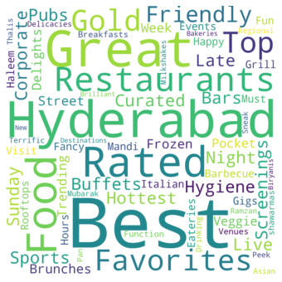
Most used words for Restaurants( Tag )

Slide 16
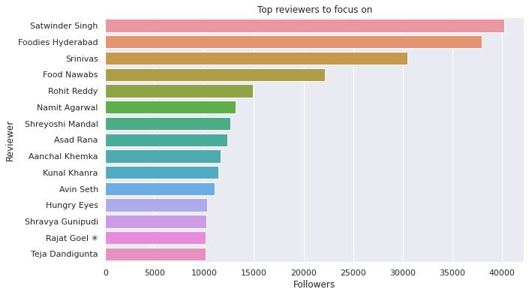
Food Critics

Slide 17
Modeling Overview
Models Used :
K-means Clustering
Hierarchical Clustering
Linear Discriminant Analysis
Non-negative Matrix Factorization
Logistic Regression
Decision Trees
Random Forest
Multinomial NB
XGBoost
LightGBM

Slide 18
Modeling Steps
Model Evaluation
Data Preprocessing
Data Fitting and Tuning
Feature selection
Feature engineering
Feature Extraction
Train test data split(75%-25%)
Start with default model parameters
Hyperparameter tuning
Measure scores on training & test data
Model testing
Compare models

Slide 19
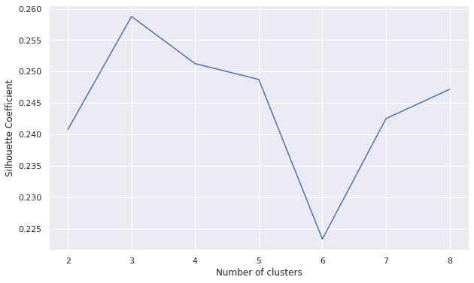
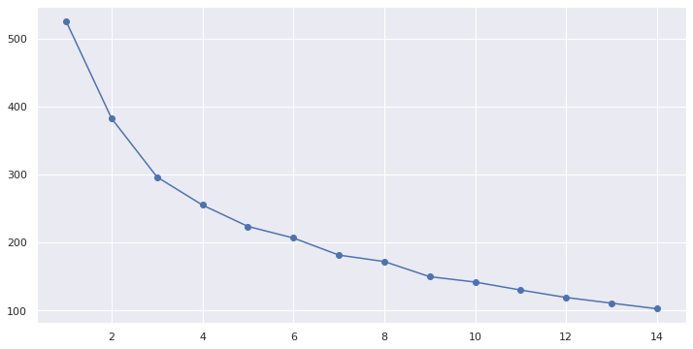
K Means Clustering Plots
Silhouette score
Sum of squares elbow plot

Slide 20
Cuisines in different clusters (K Means)
Cluster 0
Cluster 1
Cluster 2
'north indian', 'chinese', 'continental', 'mediterranean',
'european', 'seafood', 'biryani', 'hyderabadi', 'american','south indian', 'andhra', 'kebab', 'bbq', 'italian', 'asian','mughlai', 'beverages', 'modern indian', 'desserts', 'spanish',
'japanese', 'salad', 'sushi', 'mexican', 'thai', 'malaysian',
'indonesian', 'goan', 'finger food', 'healthy food'
'ice cream', 'desserts', 'cafe', 'bakery', 'continental','fast food', 'beverages', 'burger', 'biryani', 'north indian','mughlai','juices', 'chinese', 'mithai', 'american', 'wraps'
'north indian', 'continental', 'american','chinese',
'fast food','salad',
'burger','biryani', 'mughlai','asian','seafood, 'momos',pizza','hyderabadi', 'japanese','sushi', 'finger food','kebab', 'arabian', 'south indian', 'street food',
'lebanese','andhra', 'thai', 'north eastern'

Slide 21
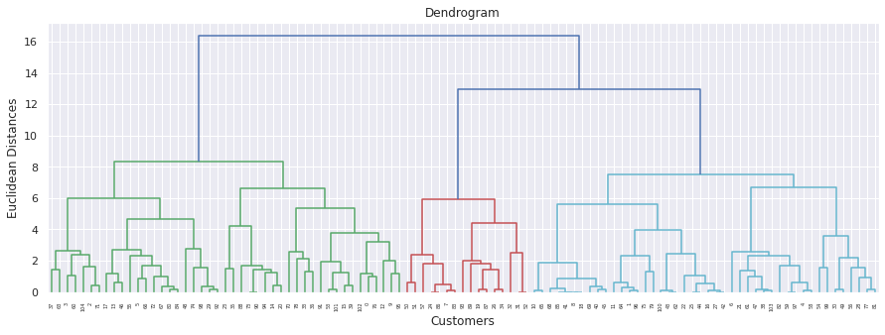
Hierarchical Clustering

Slide 22
Cuisines in different clusters (Hierarchical)
Cluster 0
Cluster 2
Cluster 1
'north indian', 'chinese', 'continental', 'mediterranean', 'european', 'seafood', 'biryani', 'hyderabadi', 'american', 'south indian', 'andhra', 'kebab', 'bbq', 'mughlai', 'italian', 'asian', 'beverages', 'modern indian', 'desserts', 'spanish', 'japanese', 'salad', 'sushi', 'mexican', 'bakery', 'juices', 'thai', 'malaysian', 'indonesian', 'goan', 'finger food', 'healthy food'
'ice cream', 'desserts', 'cafe', 'bakery', 'continental', 'fast food', 'beverages', 'burger', 'biryani', 'mithai', 'american', 'wraps'
'north indian', 'continental', 'american', 'chinese', 'fast food', 'salad', 'burger', 'biryani', 'mughlai', 'asian', 'seafood', 'momos', 'pizza', 'hyderabadi', 'japanese', 'sushi', 'finger food', 'kebab', 'arabian', 'south indian', 'street food', 'lebanese', 'italian', 'thai', 'north eastern'

Slide 23
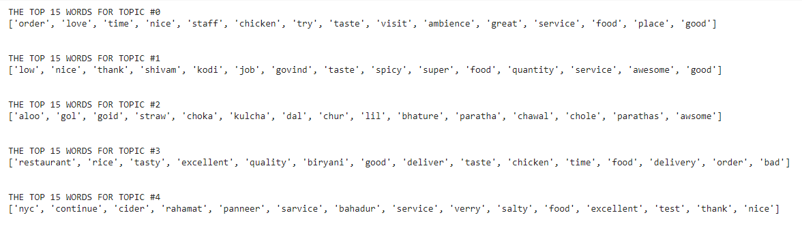
LDA top 15 word of each topic

Slide 24
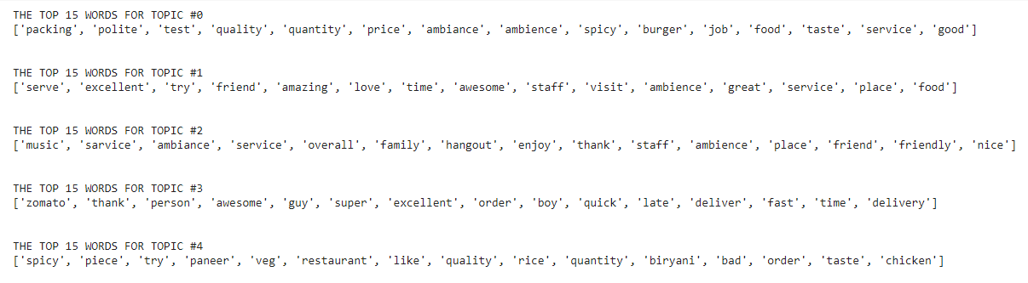
NMF Top 15 word of each Topic

Slide 25
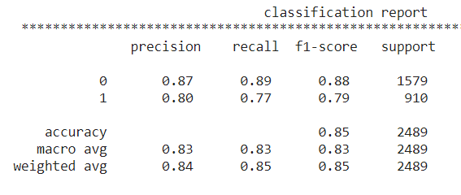
Logistic Regression
Parameters :
C = 10
Max_iter = 1000
Penalty = L2

Slide 26
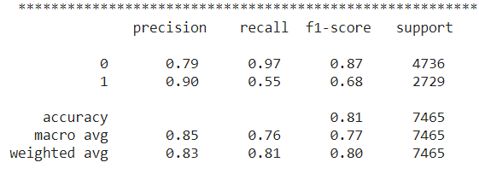
Random Forest Metrics
Parameters :
max_depth=15
n_estimators=125
criterion: entropy

Slide 27
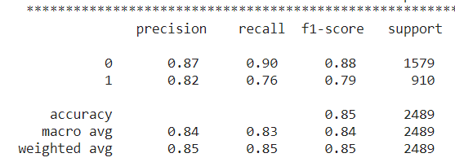
XGBoost Modelling
Parameters :
max_depth= 15
n_estimators=125
criterion: entropy

Slide 28
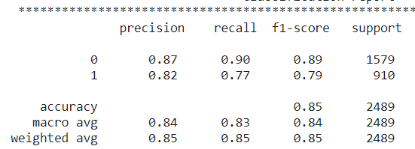
LightGBM
Parameters :
max_depth=25
n_estimators: 125

Slide 29
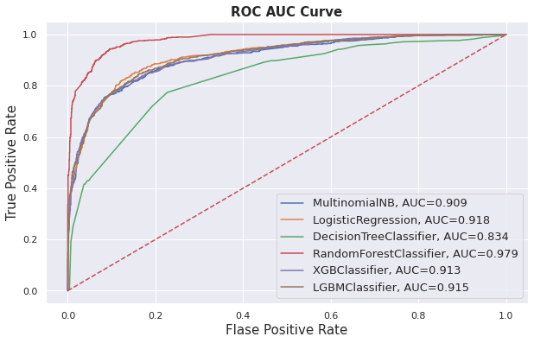
AUC-ROC curve comparison

Slide 30
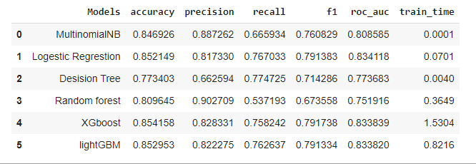
Score Matrix

Slide 31

Challenges
Feature engineering.
Finding optimum number of Cluster
Text preprocessing

Slide 32

Conclusion
We got best cluster as 3 in k means and in hierarchical
Best no of cluster for sentiment analysis (unsupervised) is 2 i.e. for positive and negative reviews
Best model we found for sentiment analysis(Supervised) are Lightgbm and logistic regression

Slide 33
Thank You

